Slide 1

Video Game Market Research and Tech Stack Study
Carlos Hernandez
Edoardo Zapata
Raul Maya
Juan Camberos

Slide 2
Who are we?
Data Divers

Slide 3

Data Divers
We are a company specialized in data analysis.
We produce quality insights and conclusions for our clients based on data, from which them will be able to generate strategies to maximize the potential of their business.

Slide 4
Who is our client?
Crazy Games

Slide 5

Core business strategy
Crazy Games
Crazy Games has hired us to do the job for them. They want insights to reduce risk and maximize the success potential when developing a game, answering the following question :
Young mexican company that wants to enter the mobile videogames market.
They are looking for someone to hire to perform an analysis on Google Store and Apple Store to generate valuable insights for them.
Client objective

Slide 6
What are the questions that we want to answer?
Most successful ranking evaluation (downloads, sales, rating. etc) within different OS?
Most successful mobile games ranking and what is behind?
What is the most used technological stack (operating system) within the market vs top ten mobile games ranking?
Most successful sale business model for mobile games?

Slide 7
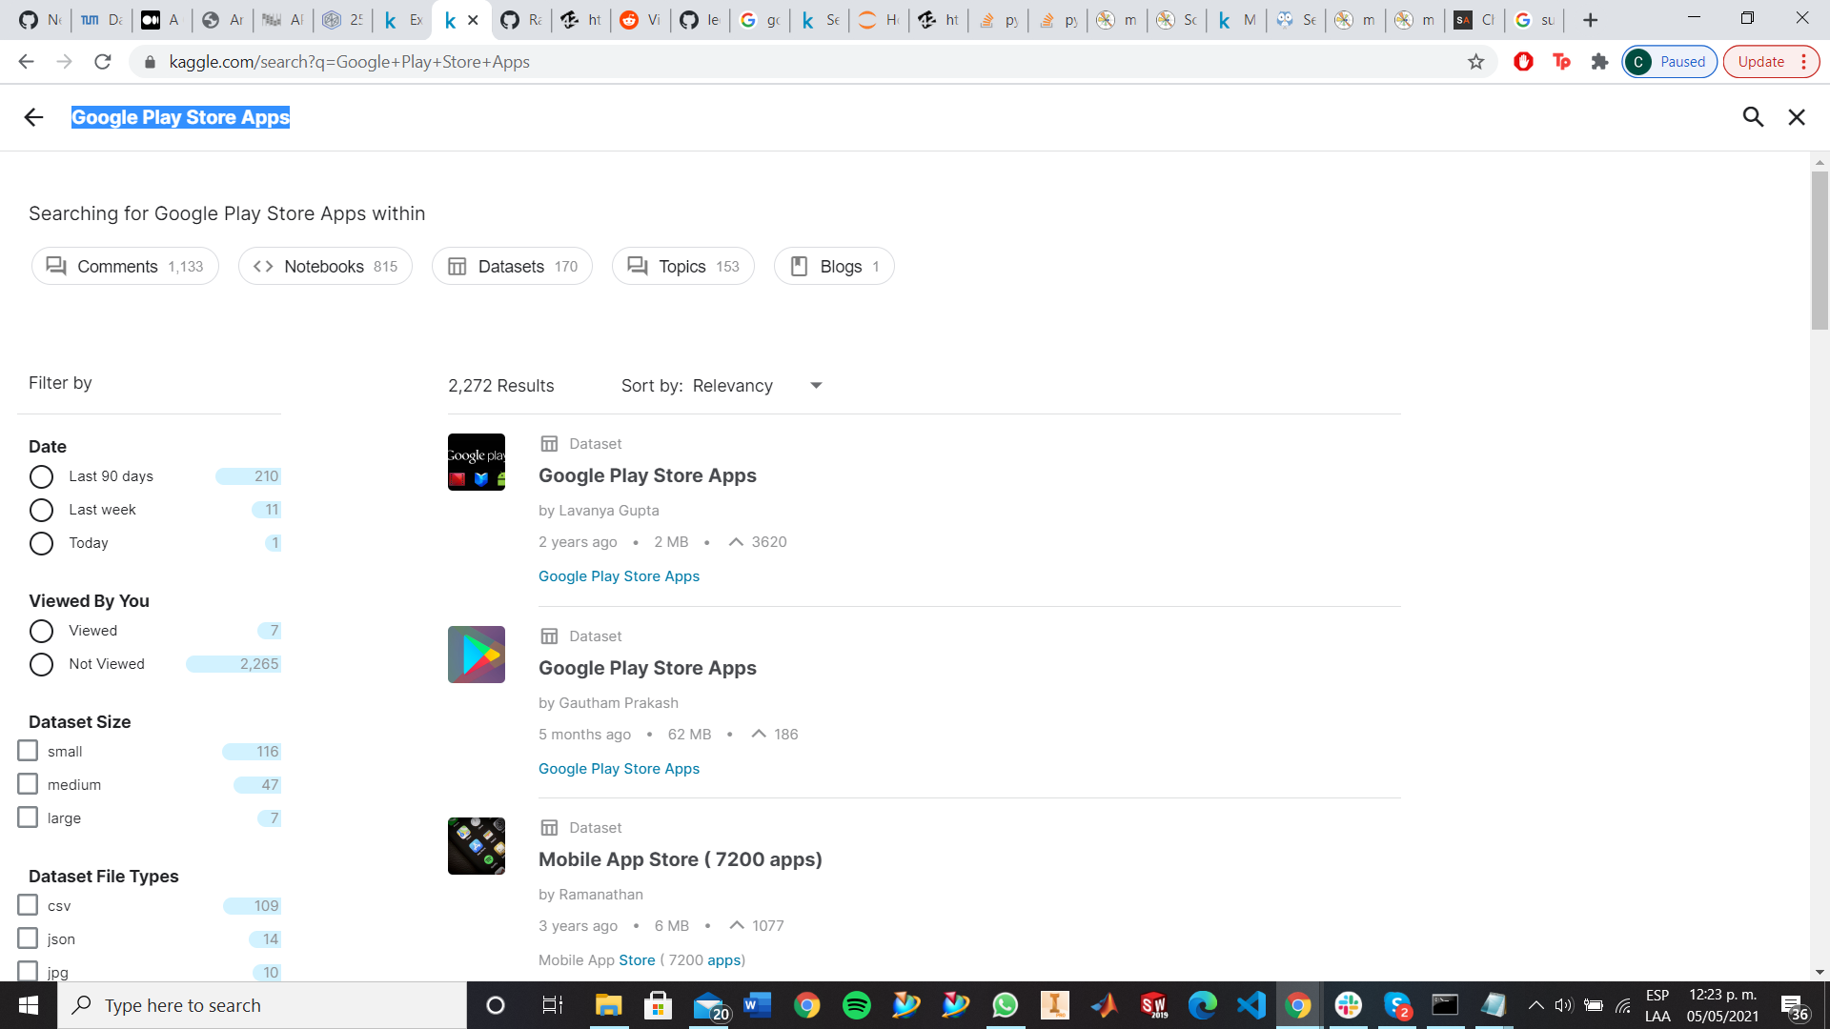
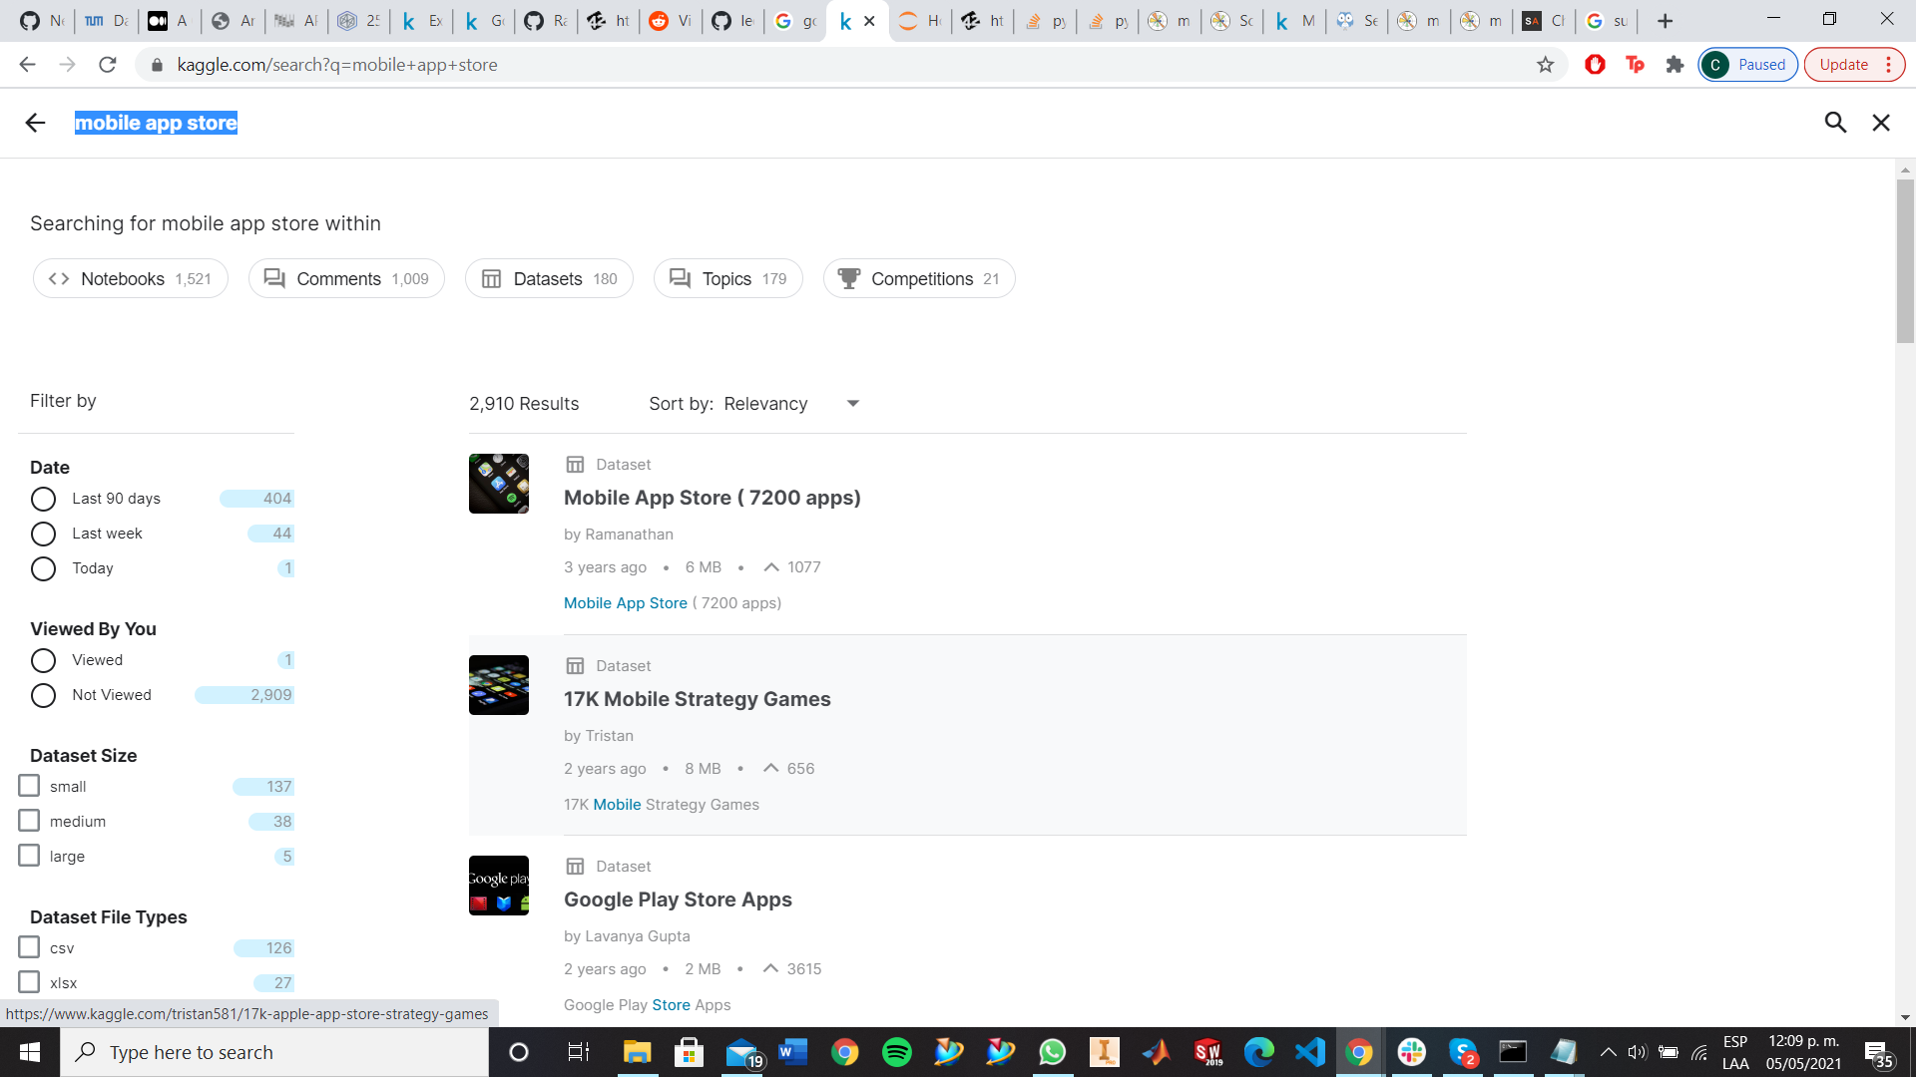
Datasets finding
The process was hard, but through Kaggle we found the following datasets

Slide 8
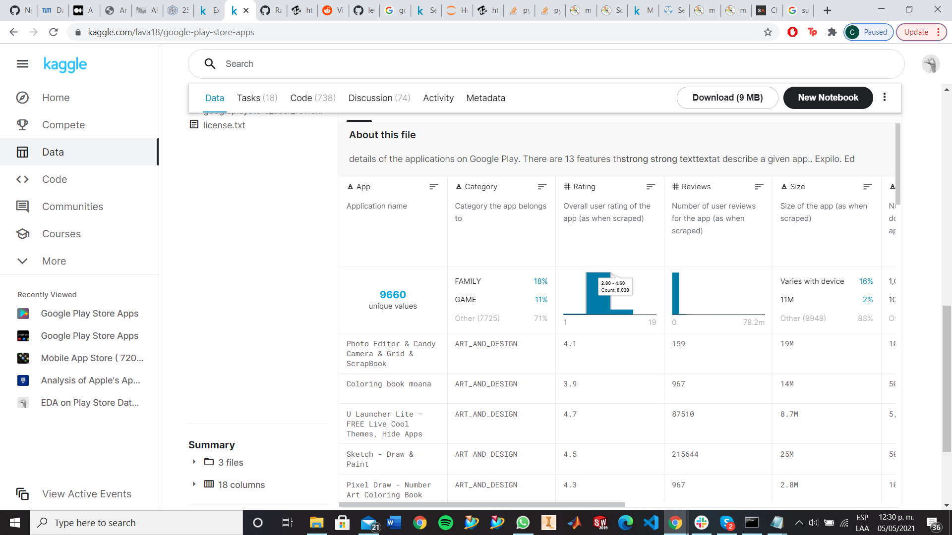
Google Play Store App
Very complete dataset which includes 9660 unique records.
Insightful categories such as Category, Rating, Installs, Type, Price, Content Rating, etc.
Free.

Slide 9
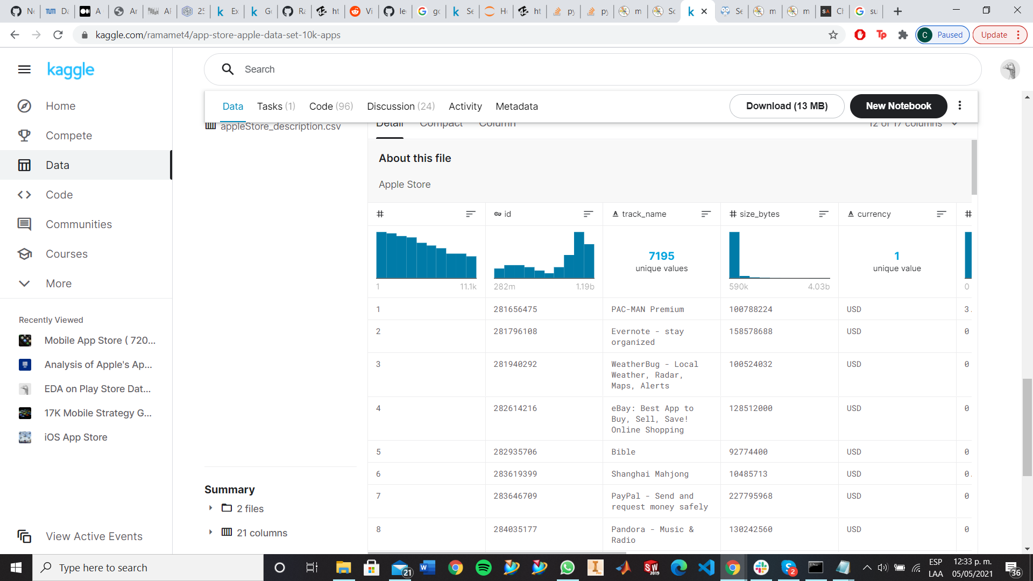
Mobile App Store
(Apple Store)
Large dataset with approximately 7197 unique records.
Useful categories such as Price, Rating Count, Content Rating, Primary Genre, etc.
Free.

Slide 10
Data Cleaning

Slide 11
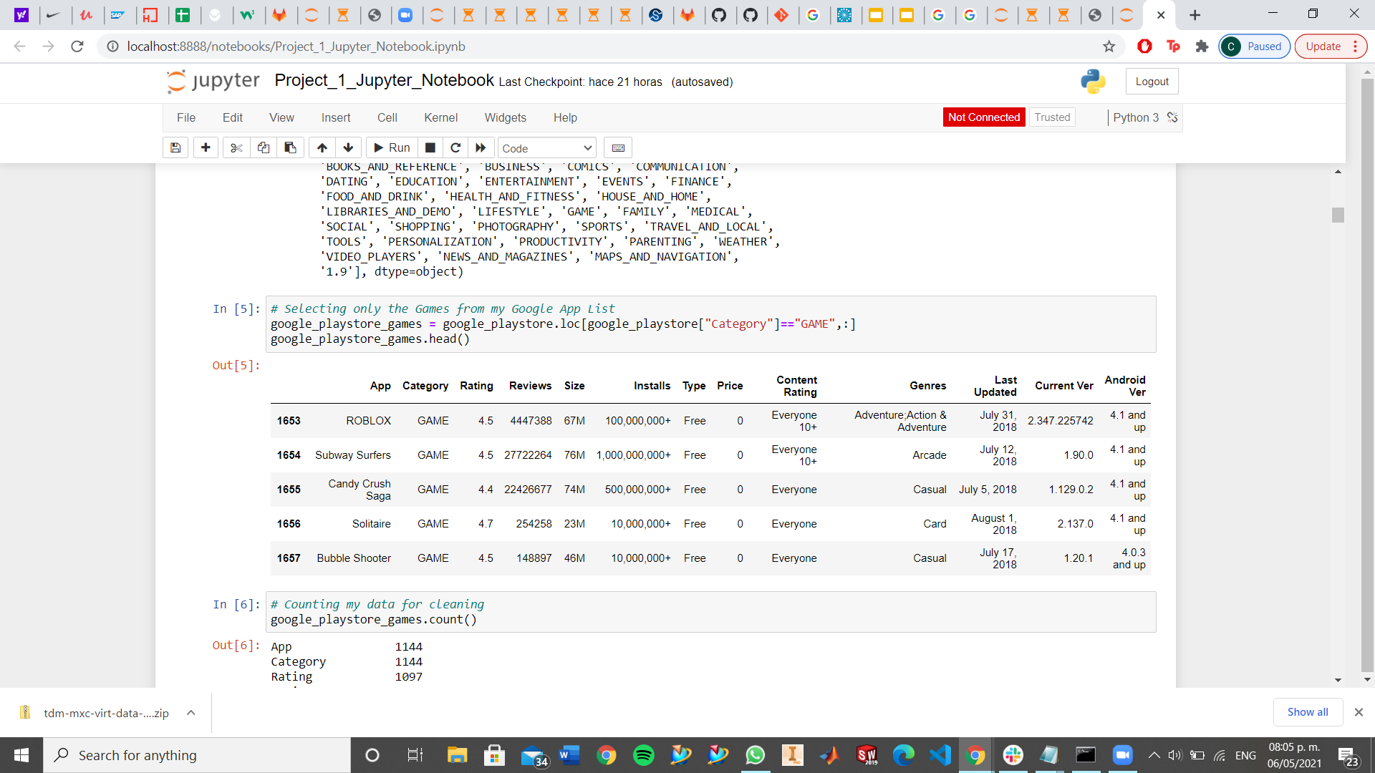
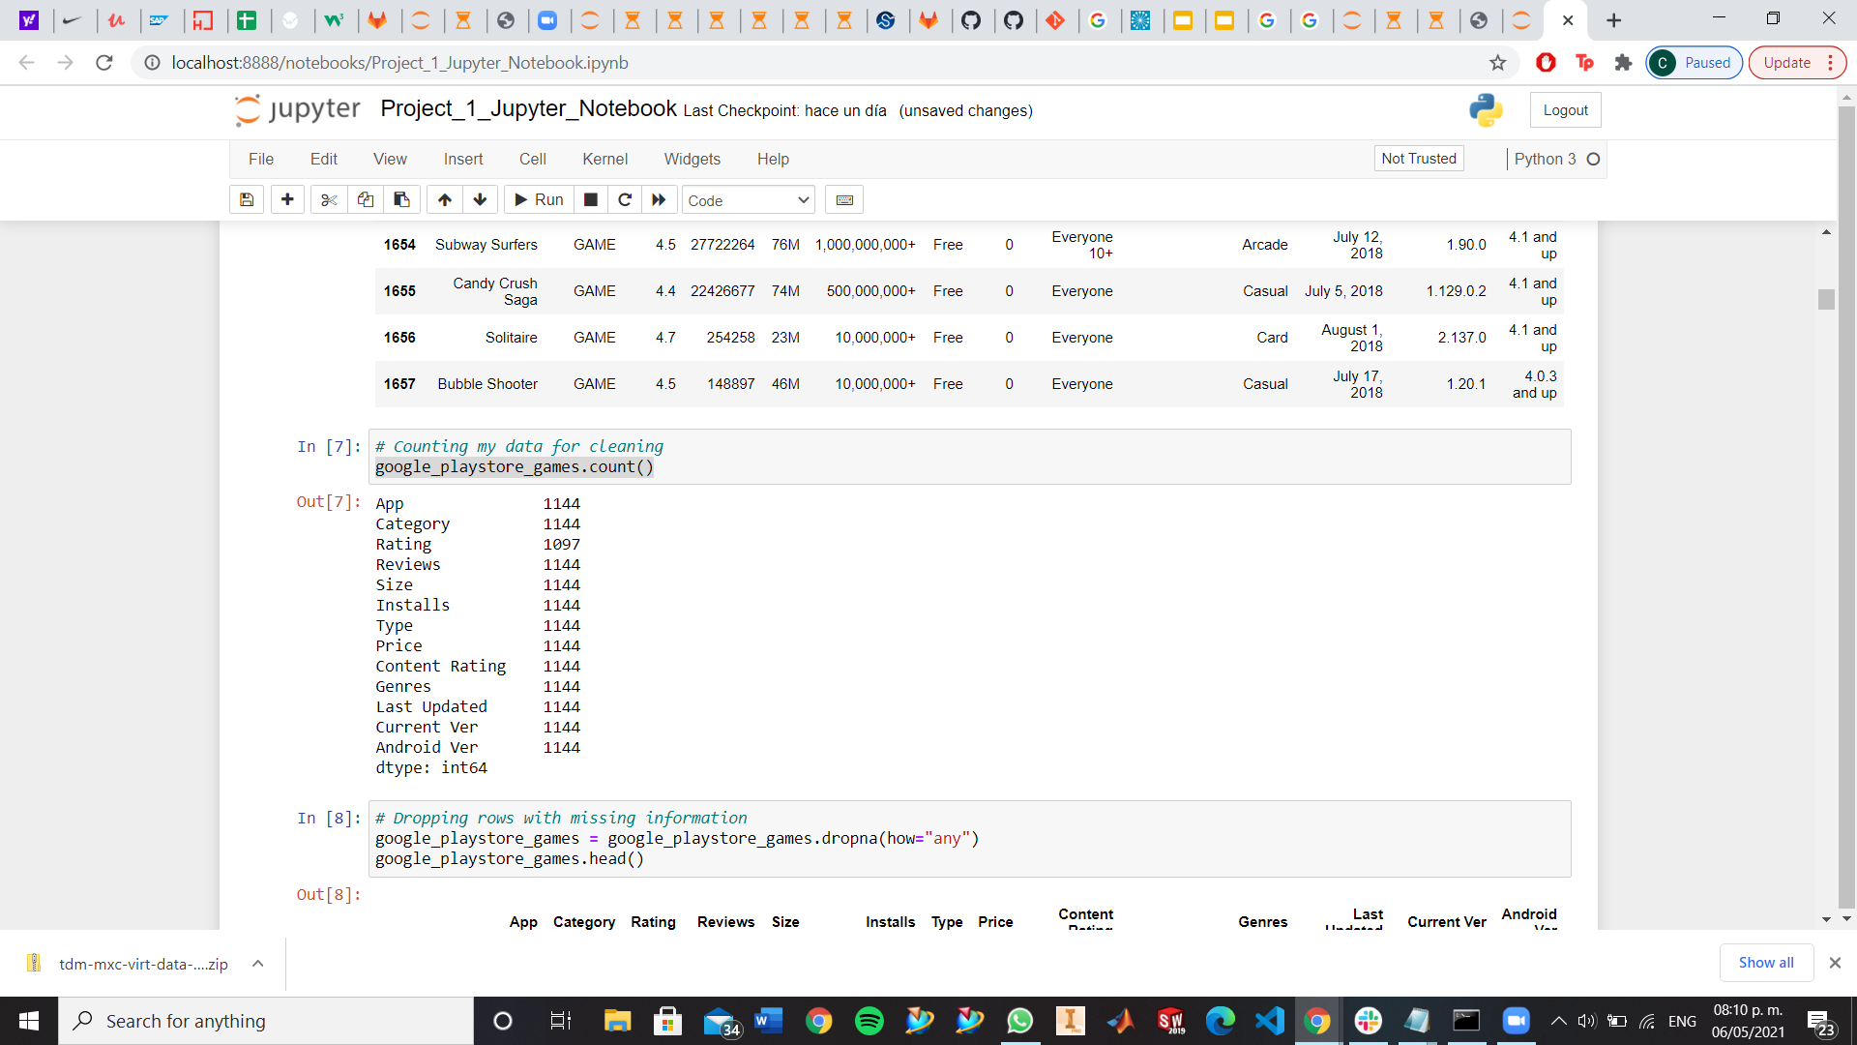
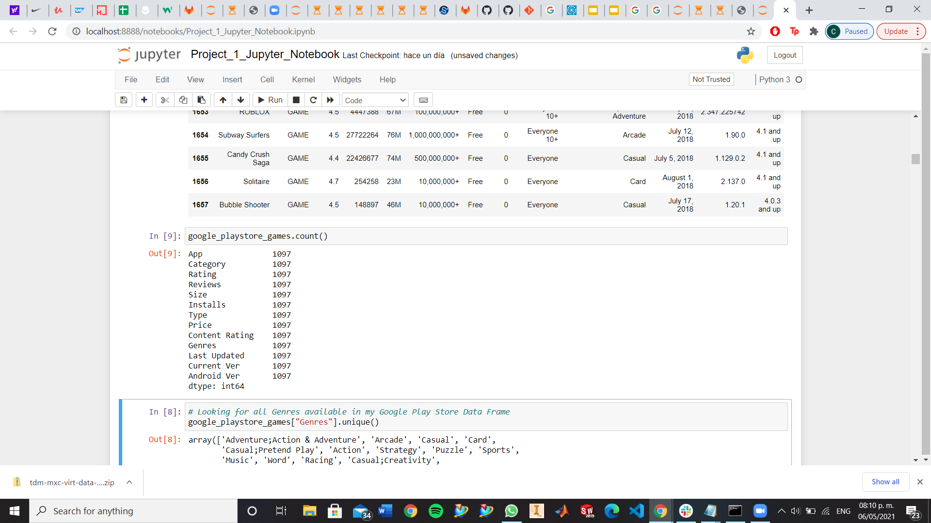
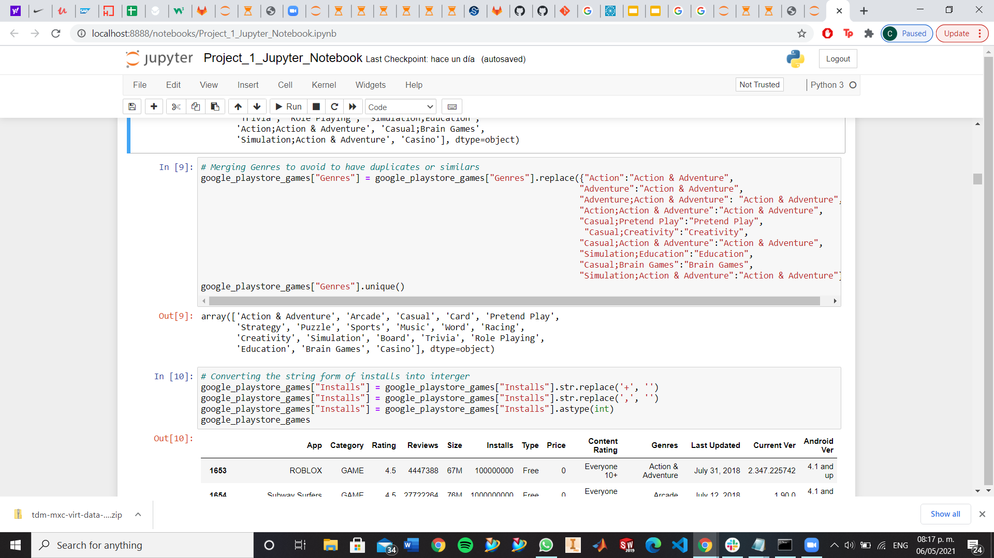
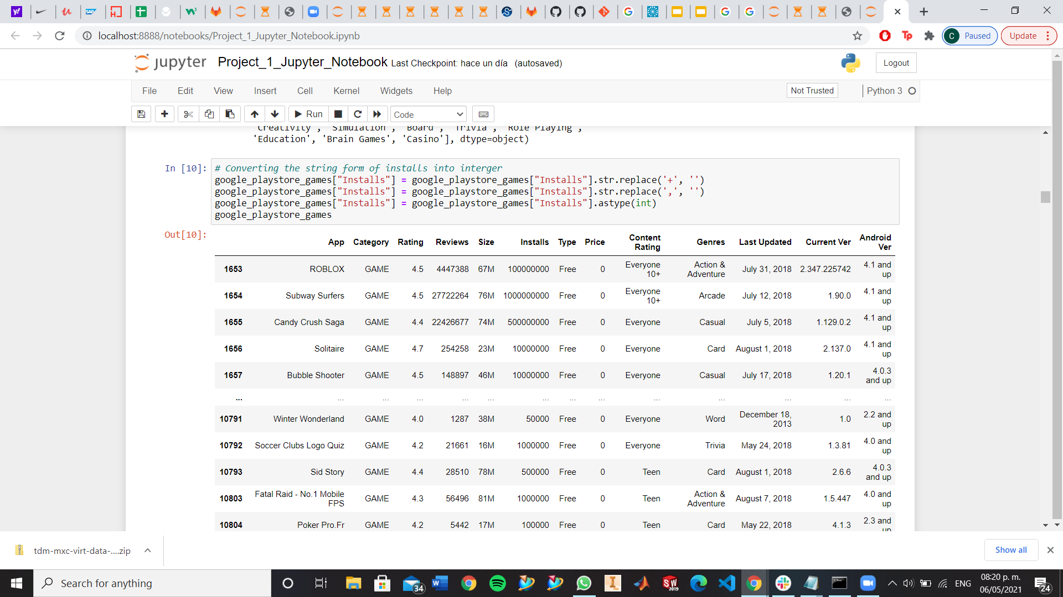
Google Play Store App
Filtered the data set, to obtain just the Games Category.
Eliminate useless rows.
On Category column, merge common values.
Convert Installs column from string to column.

Slide 12
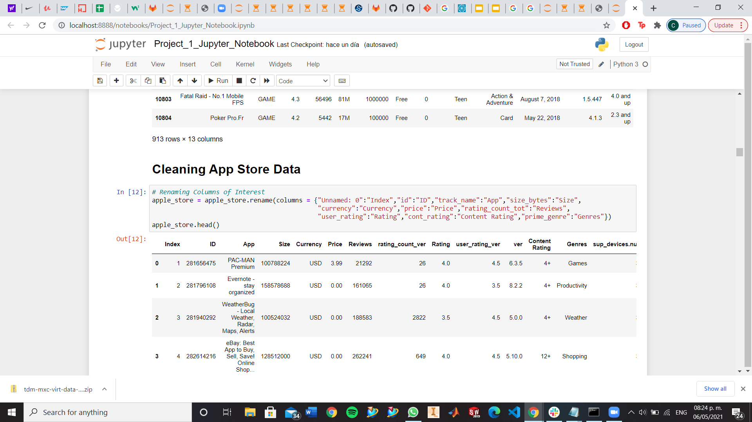
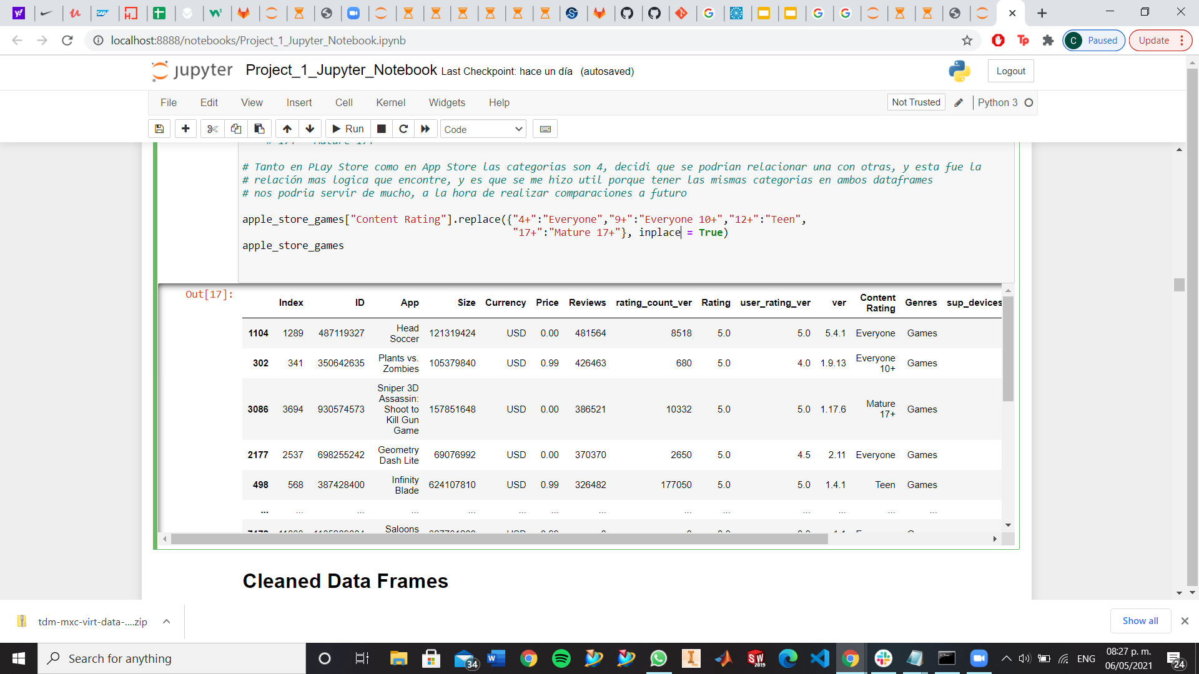
Apple Store
Renamed columns to a more understandable name.
Replaced columns from Content Rating, to values that are the same as Google Play Store.

Slide 13
Analysis

Slide 14
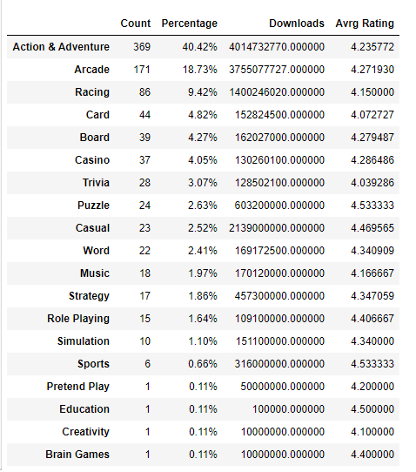
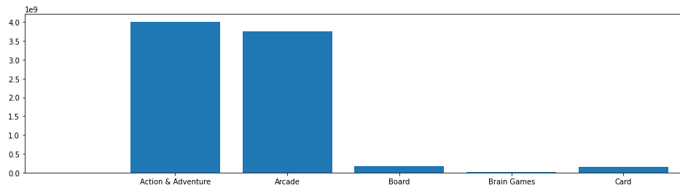
Most successful mobile games categories in different OS
Conclusions: The most successful game genres in the play store are Action & Adventure and Arcade. These being both the most developed game genre in the store (representing about 59% of the dataset) and the most downloaded by its users.

Slide 15
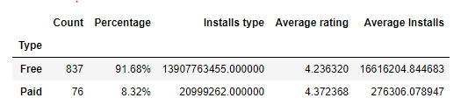
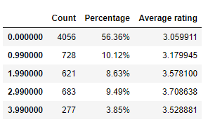
Most successful mobile games categories in different OS
Play store free vs paid game apps
Apple store free vs paid game apps
Conclusions:
On the Playstore; the vast majority of the games are free-to-play, and only a small portion charge it to play. This differs with the app store where only 56% of the apps are free and the rest are actually paid. This might be due to the different processes that the developers have to go through to upload their games to their respective store.
Paid games overall have a better user rating than free games on both stores. This might be due to various reasons; being that the game developers have a fanbase that appreciate their games, the average quality of a paid vs free game is often better. etc.
So, the success potential for a new game is pretty high when using freemium models for a core genres (Action & adventure, arcade) to keep the traffic cycling through the new game and develop a followership from there.

Slide 16
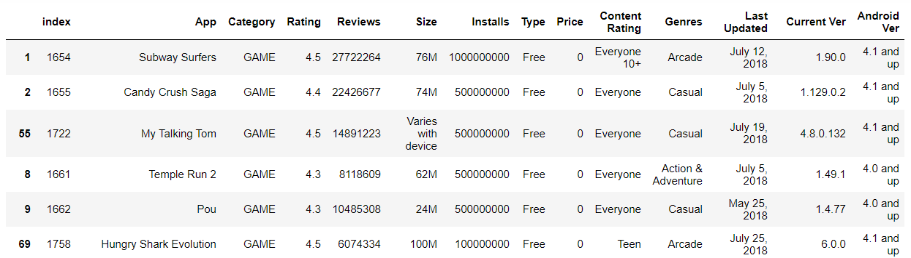
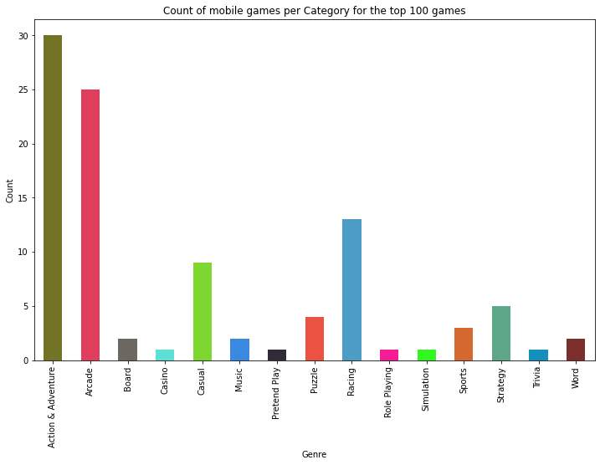
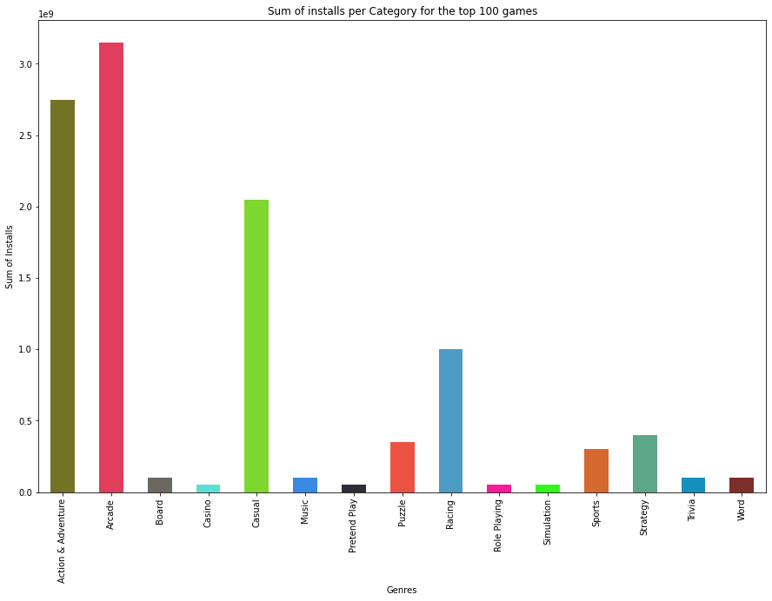
Most successful mobile games ranking and what is behind?
Based on Installs
Top Genres from top 100 teams are: Action & Adventure, Arcade, Racing and Casual.
Sum of Installs for this category show Arcade at top.
Google Play Store
Game should be one of the previous genre

Slide 17
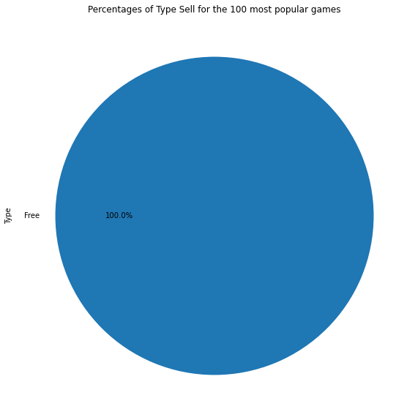
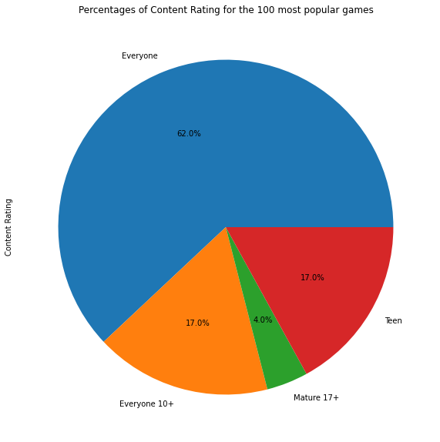
Most successful mobile games ranking and what is behind?
Google Play Store
100% of top 100 games are free
Almost 80% of the Content Rating is Everyone and Everyone+, meaning accesible content is better.
Games should be free and between Everyone and Everyone +10

Slide 18
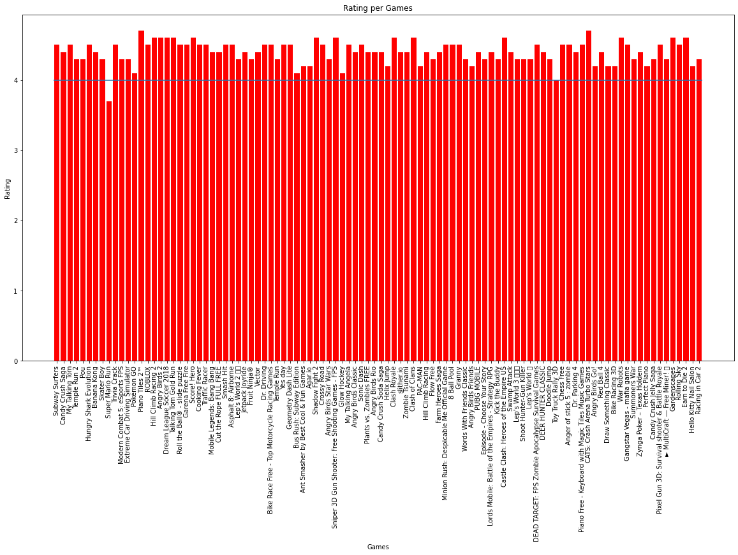
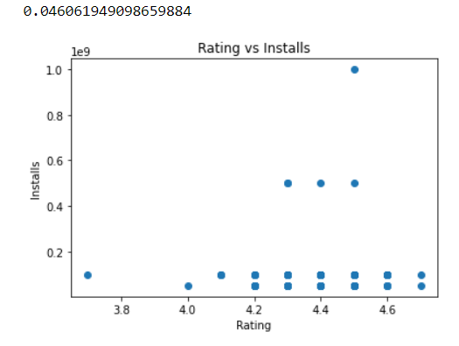
Most successful mobile games ranking and what is behind?
Google Play Store
Average rating for is 4.33, almost all games have an 4+ rating.
At this level, the correlation between Rating and Installs is non existant.

Slide 19
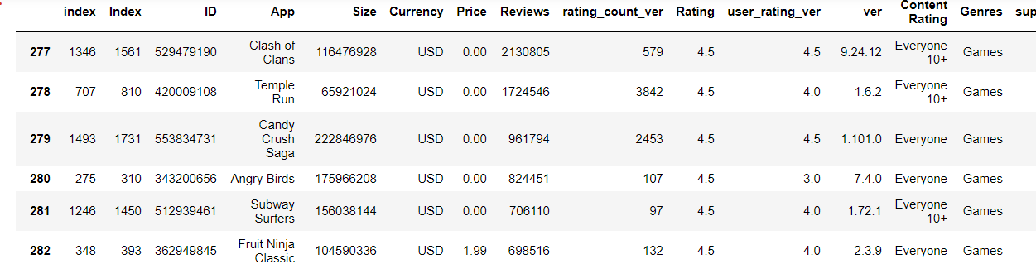
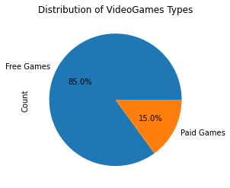
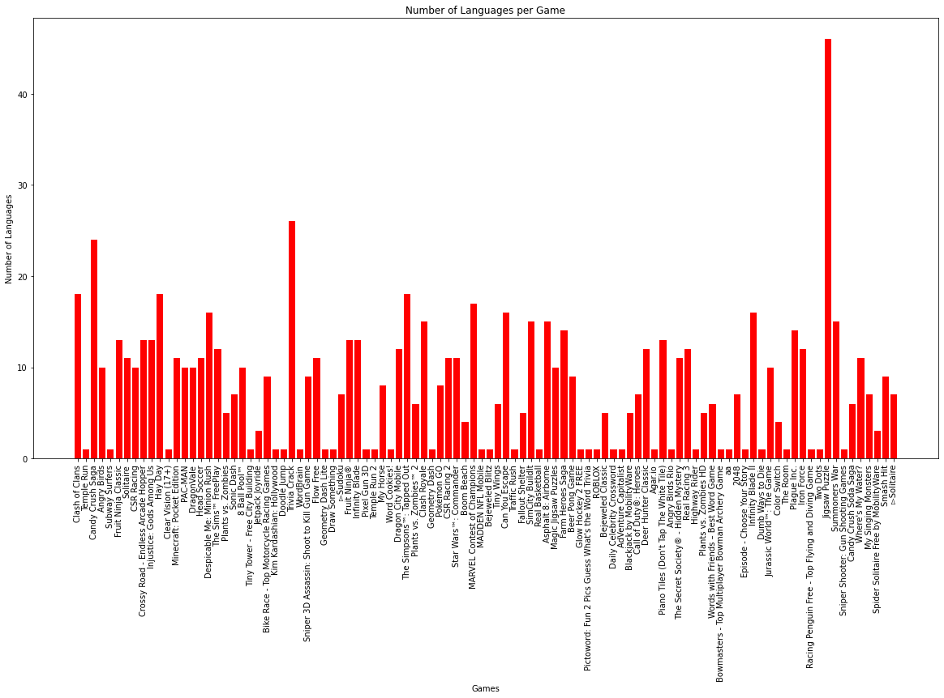
Most successful mobile games ranking and what is behind?
As well as Google, the majority of games are paid.
The average price obtained was: $0.2584
The most expensive app was: $6.99
Apple Store
Average languages: 7.89

Slide 20
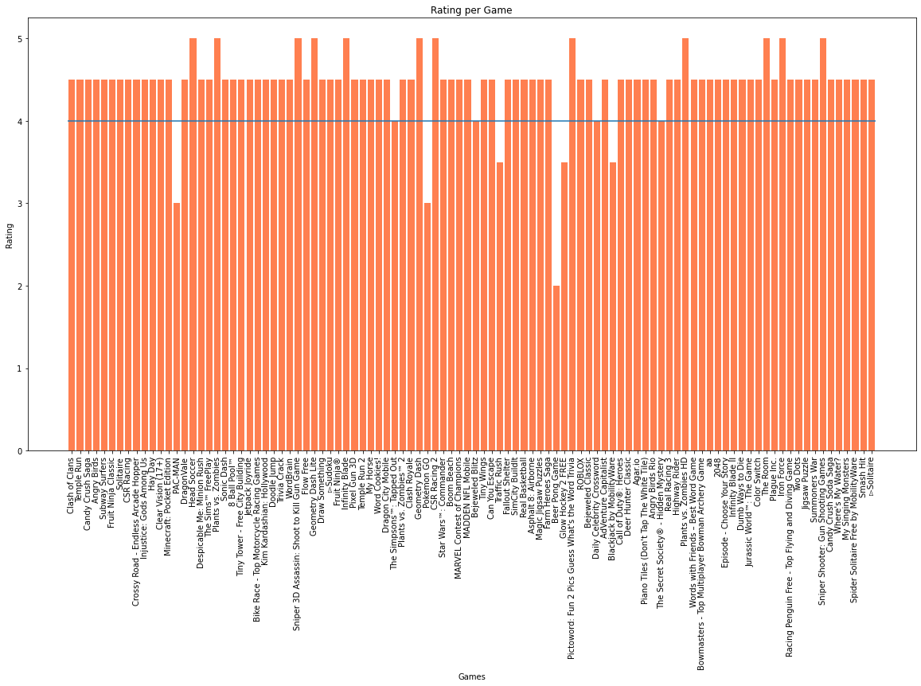
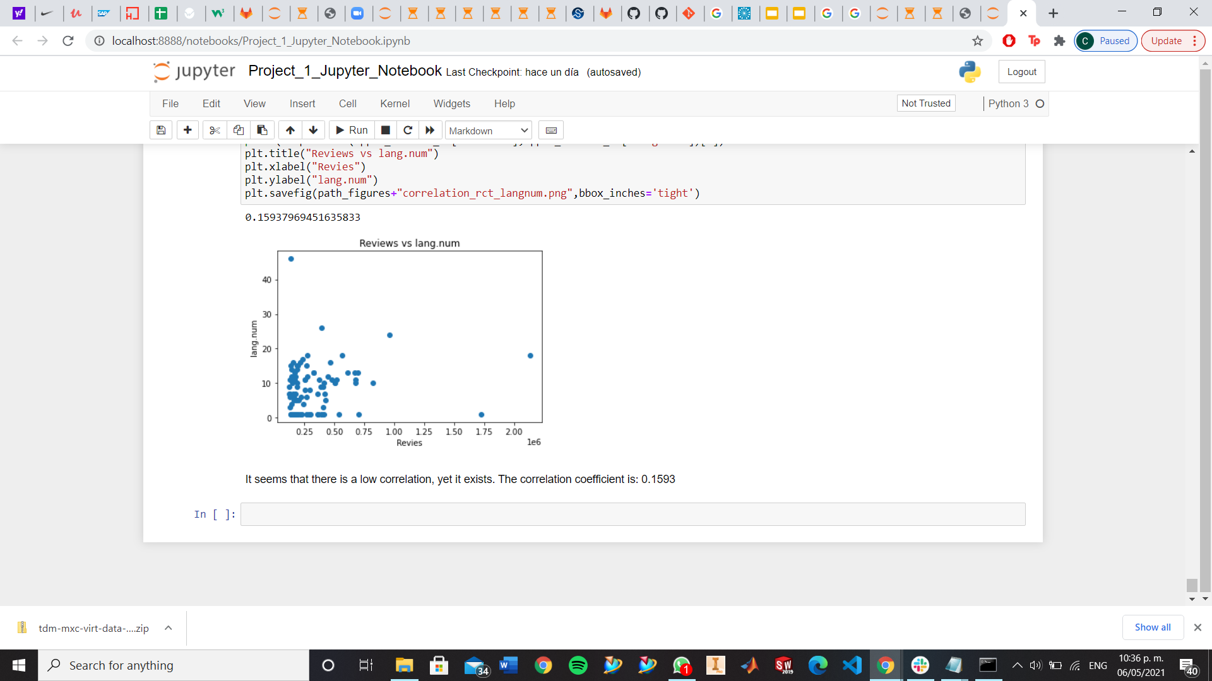
Most successful mobile games ranking and what is behind?
Apple Store
Games should be free, but Paid can be accepted.
More languages mean that more people are more likely to play it.
Average rating for is 4.45, almost all games have an 4+ rating.
We tried to get a correlation for Reviews vs Language Numbers. It seems a little bit low, yet existant.

Slide 21
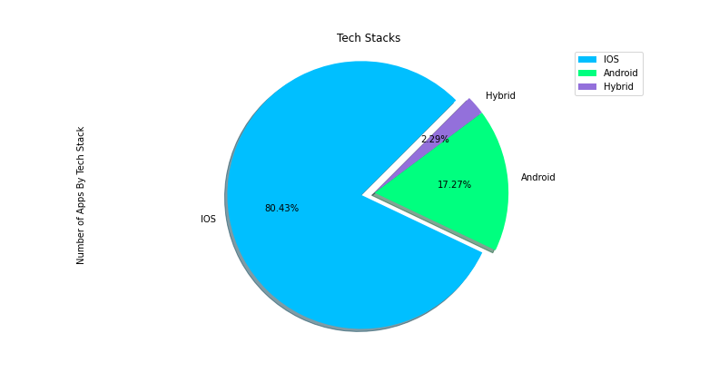
3. What is the most used technological stack (operating system) within the market vs top ten mobile games ranking?
 | Number of Apps by Tech Stack
IOS | 3753
Android | 806
Hybrid | 107

Slide 22
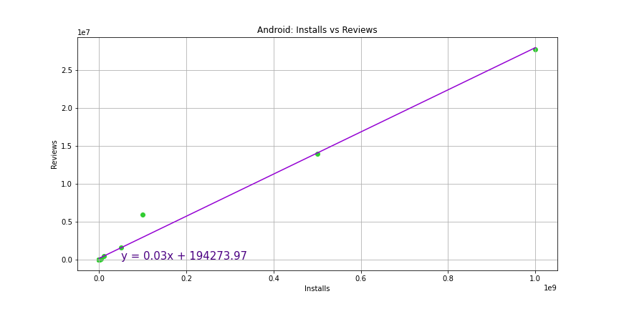
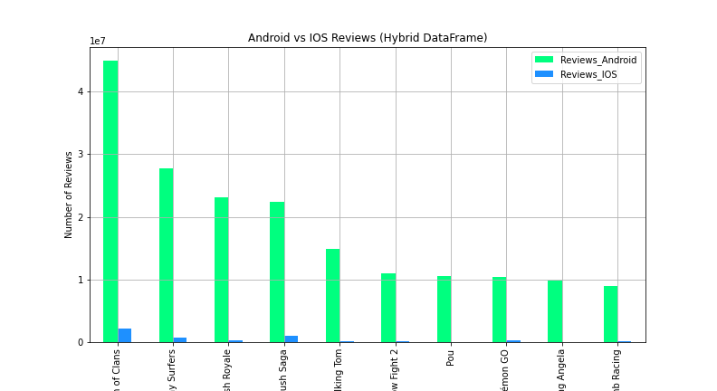
3. What is the most used technological stack (operating system) within the market vs top ten mobile games ranking?

Slide 23
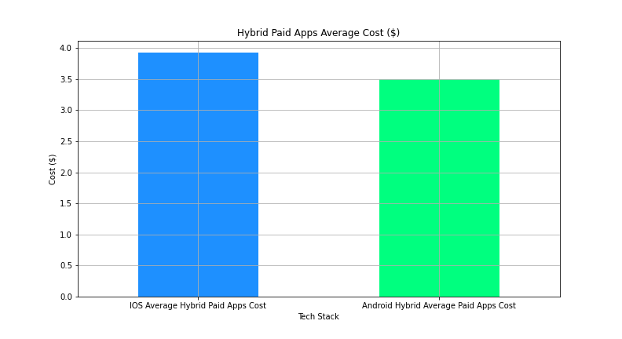
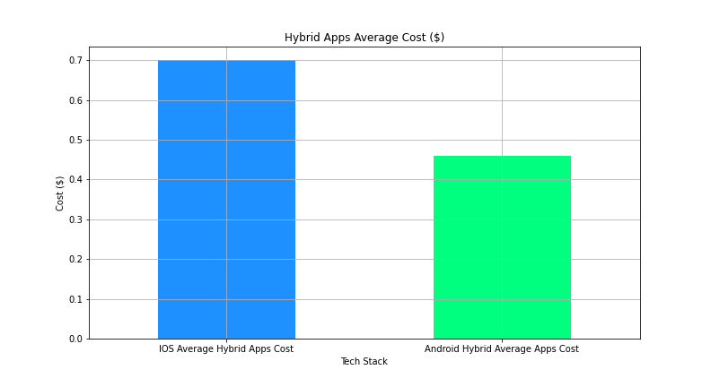
3. What is the most used technological stack (operating system) within the market vs top ten mobile games ranking?
Even though we can sell our apps in a more expensive way in the App Store. For starting an app is better to upload it to the Google Play Store, because there are more users that review it, so we can get a feedback, and analyze how the app could do in the App Store.
Description | Average Price
IOS Average Hybrid Paid Apps Cost | $3.92
Android Hybrid Average Paid Apps Cost | $3.49
Description | Average Price
IOS Average Hybrid Apps Cost | $0.70
Android Hybrid Average Apps Cost | $0.46

Slide 24
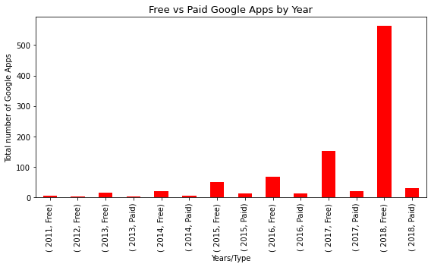
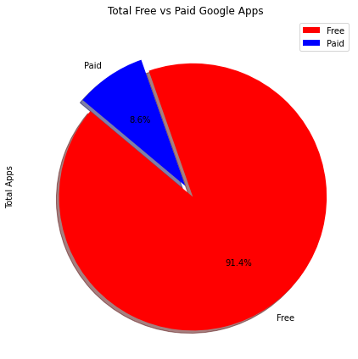
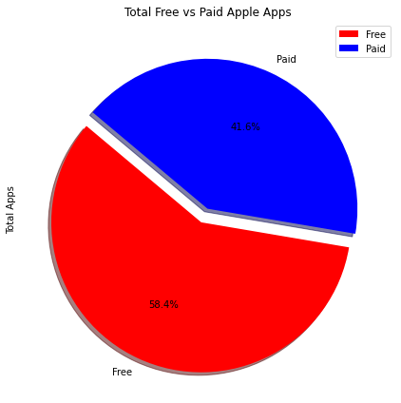
4. Most successful sale business model for mobile games?
Conclusions
Based on the study and data Free mobile games are the most successful business model for the following reasons :
More easy engage with the client to let him try and then buy.
Better opportunities to increase revenue by running ads or gaming level, features payment.
Google app store is most likely to be the store to start launching game due to following reasons:
Cheaper to develop using Java.
Easier way to deploy and upload the app into the store compering to iOS deployment, licensing and security validation flow.
Google Apps
Apple Store

Slide 25
Conclusions
3. What is the most used technological stack (operating system) within the market vs top ten mobile games ranking?
The average price for iOS apps are higher than Google apps
There are more people that gives a feedback in Google Apps then in IOS
For getting known, is better to upload the app to Google Apps Stores
4. Most successful sale business model for mobile games?
More easy engage with the client to let him try and then buy.
Better opportunities to increase revenue by running ads or gaming level, features payment.
Google app store is most likely to be the store to start launching game due to following reasons:
Cheaper to develop using Java.
Easier way to deploy and upload the app into the store compering to iOS deployment, licensing and security validation flow.
Most successful ranking evaluation (downloads, sales, rating. etc) within different OS?
The most successful game genres in the play store are Action & Adventure and Arcade. These being both the most developed game genre in the store (representing about 59% of the dataset) and the most downloaded by its users.
Most successful mobile games ranking and what is behind?
Games should be free and between Everyone and Everyone +10
Game should be one of the previous genre
Games should be free, but Paid can be accepted.
More languages mean that more people are more likely to play it.

